Slide 1
Special Relativity

Slide 2
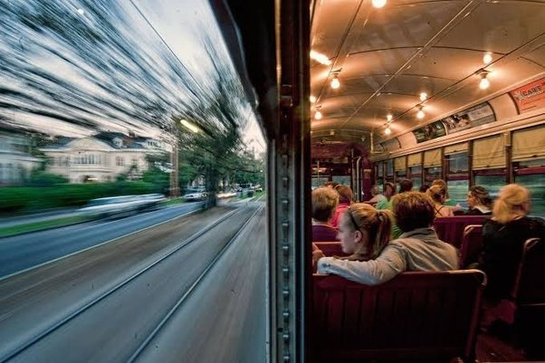
Galilean Relativity
In a bus travelling along a highway at 100 km h⁻¹, you throw a ball to your friend, who is two rows ahead of you, at 10 km h⁻¹. How fast was the ball travelling?
You and your friend observe the ball moving at 10 km h⁻¹.
A worker standing beside the highway observes the ball moving at 110 km h⁻¹.
To the driver of a car that is overtaking the bus with a speed of 110 km h⁻¹, the ball does not seem to be moving at all.
Now imagine that the bus is moving smoothly and silently through a pitch-black tunnel. Without looking at the speedometer, do you have any way of telling how fast you’re going – or if you’re even moving at all?

Slide 3

Galilean Relativity
Galilean relativity (a.k.a. Galilean invariance) states that all the laws of motion hold true in any inertial frame of reference – that is, as long as you aren’t accelerating.
As a result, there is no such thing as ‘absolute velocity’ – the velocity of an object can only be measured relative to another object.
Measuring forces allows you to determine acceleration (and vice versa), but there is no way to tell whether you are moving from within your own frame of reference.
No frame of reference takes priority over another, so it is equally valid to say that:
you are driving your car forward along a road
the Earth is moving backwards beneath your stationary car

Slide 4

Notes:
Full video (which goes well beyond what you need to know) can be found at https://youtu.be/FdWMM6aXpYE

Slide 5
Example #1
Which of the following are pairs of inertial frames of reference?
A physics student sitting next to another physics student during a test.
A physics student sitting a test while the teacher walks in a straight line down the middle of the classroom at a constant speed.
A physics student sitting a test while the teacher walks around the edges of the classroom at a constant speed.

Slide 6
A Problem for Galilean Relativity
In the late 1800s and early 1900s, a growing body of evidence suggested that the speed of light was absolute: that light always moved at c, regardless of the velocity of the emitter.
Einstein: “Any ray of light moves … with determined speed c, whether the ray be emitted by a stationary or by a moving body.”
If you shine a light at your friend in the bus, they observe the light travelling at c, not c + 100 km h⁻¹.
If your friend shines a light at you, you observe the light travelling at c, not c – 100 km h⁻¹.
This can lead to some very unintuitive conclusions…

Slide 7


Slide 8
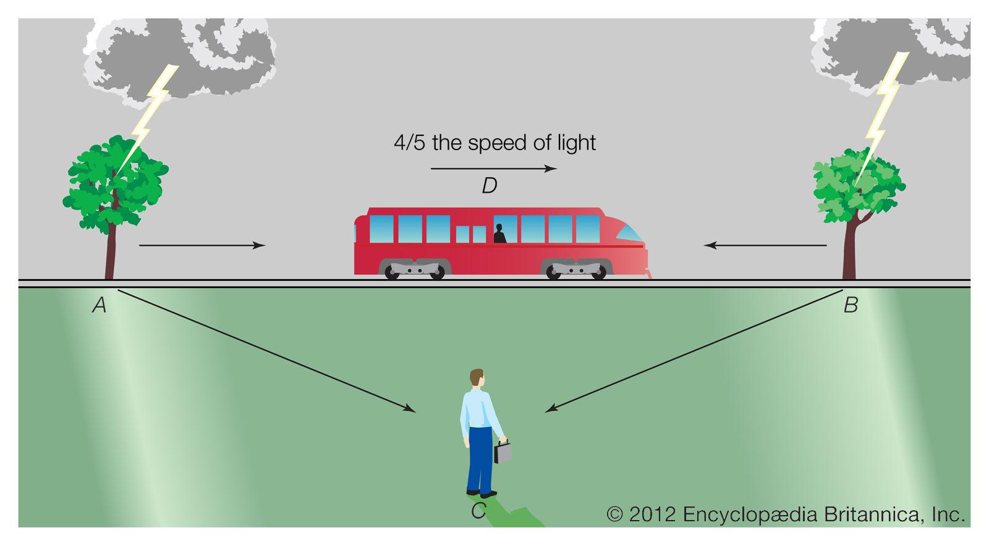
Relativity of Simultaneity
Since the speed of light does not change, time itself ‘bends’ to accommodate it in situations with moving reference frames.
This means that events that are simultaneous in one frame of reference may happen at different times in another frame of reference.
At non-relativistic speeds (i.e. speeds much slower than c) these effects are insignificant and impossible to measure.
Because of this, it is often easier to consider them using thought experiments (or, as Einstein called them, Gedankenexperiments).

Slide 9
Example #2
Aaron is standing in the middle of a train carriage moving at 0.8c. Belinda is standing on a platform alongside the train track. As the middle of the carriage passes Belinda, Aaron switches on a light directly above him.
Describe and explain any differences between Aaron and Belinda’s observations of the light in the train.
Would the sound of the switch clicking reach the ends of the carriage simultaneously in both frames of reference or only one? Explain your answer.

